Slide 1
Neural Nets: training, deep learning

Slide 2
Review from last time
A Perceptron is a unit of machine learning modeled after the neuron
Uses an activation function to feed information forward
You can combine multiple perceptrons into a Multi-layer perceptron
Adding multiple layers allows you to capture more interesting patterns/functions

Slide 3
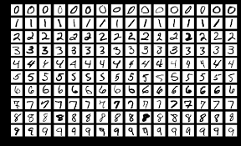
In-class exercise in groups of 2-3 students [end of class]
We’ll classify hand-written digits using a two layer MLP model
The dataset is the popular MNIST dataset
There are ten possible classes: what is the size of our last layer?
Each MNIST image is 28x28 single color -- how many inputs?
What are we looking at in the example?
28x28 = 784 input features are mapped to 40 neurons in the hidden layer
Each of the 40 neurons therefore has 784 weights
Let’s draw it
We can convert the weights of a single neuron into a 784 = 28x28 image
Go over MLP example in python: https://scikit-learn.org/stable/auto_examples/neural_networks/plot_mnist_filters.html#sphx-glr-auto-examples-neural-networks-plot-mnist-filters-py
They are graphing the weights of the first 16 of these 40 neurons in the hidden layer
Do any of these neurons look “smart”? Any combinations?

Slide 4
In this lecture we will
Understand how to train MLPs (NNs)
Feeding information forward to make a prediction
Updating weights across multiple layers using back-propagation
Understand basic ways to improve training performance of NNs
Understand the basic idiom for training NNs
Deep learning
Give a history of NNs and deep learning, and its applications
Understand vanishing gradient problem and ReLu
Understand dropout
Introduce PyTorch for deep learning
Training on GPUs with tensors

Slide 5
Two-Layer Neural Networks
Two-layer NNs (single hidden layer) are universal function approximators
More complex decision boundaries can be discovered than with other models
These models are also capable of learning which features are important, and which can be ignored
In fact, with NNs “you don’t need to do feature engineering”
Layered NNs are made of up of:
The input layer: these are the features
The output layer: returns the model decision (i.e. what class does this input vector belong to?) -- one node per class
One or more hidden layers: these are internal neurons that learn the complex relationship the model is representing
An activation function: depending on your use case, you’ll select an appropriate activation function
But wait, how do we update the weights of each neuron correctly if we have multiple neurons?
We only know if we got the right prediction or not “at the end” of the NN in the output layer

Slide 6
Solution: feed-forward and back-propagation
To train a multi-layered NN, we:
Feed the inputs to the input layer, calculate activations, and “feed forward” the results of each layer until the output layer is reached where the decision is made
Once we know our prediction, we use “back propagation” to adjust all the weights of all the nodes in the NN correctly
Feeding information forward is pretty obvious
Back propagation assigns each node’s weights a potential new value
By examining how much each weight of each node contributed to the mistake in prediction
Takes the error of the output neuron, looks at the weights used as its inputs, and pushes that weighted error back into the hidden neuron
Nice visualization: https://www.youtube.com/watch?v=Ilg3gGewQ5U

Slide 7
Visualizing feed-forward and back-propagation
Video from: https://www.youtube.com/watch?v=Ilg3gGewQ5U

Slide 8
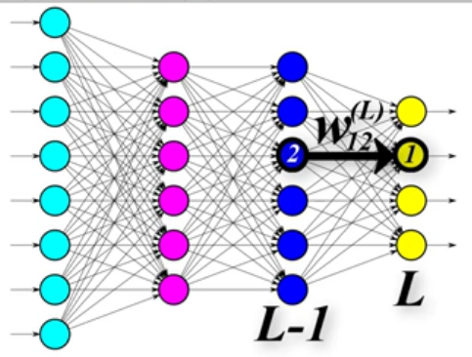
Back propagation algorithm
Images from https://www.youtube.com/watch?v=Zr5viAZGndE&list=RDCMUC4UJ26WkceqONNF5S26OiVw&index=2
Each yellow node represents one of four classes we want
For a wrong prediction, we want one yellow node’s activations to increase, the rest decrease
Goal: update all the weights in the neural net to achieve these changes
How: calculate how much each individual weight needs to change (and in what direction)
Each weight change depends on who it feeds data into

Slide 9
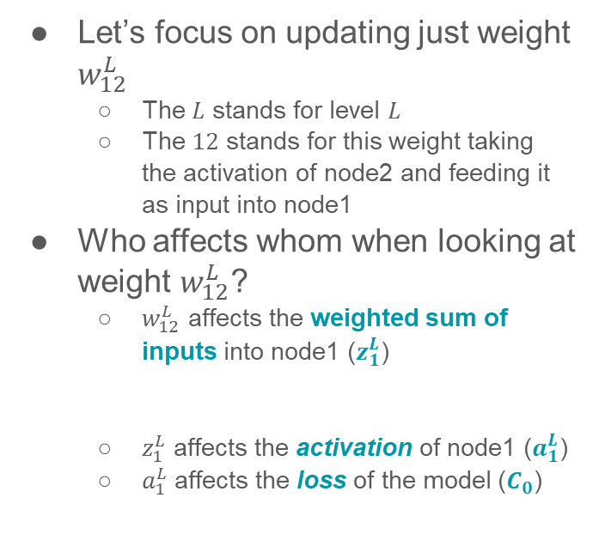

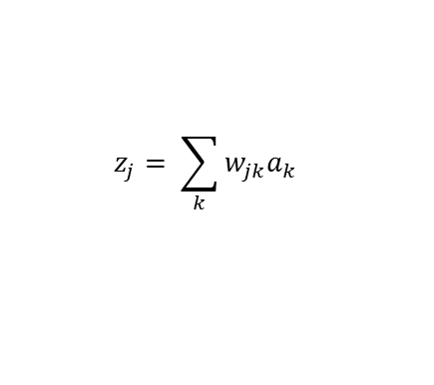
Back propagation algorithm: mathematical notation
Images from https://www.youtube.com/watch?v=Zr5viAZGndE&list=RDCMUC4UJ26WkceqONNF5S26OiVw&index=2
$w_{12}^{L}$ $→ z_{1}^{L}→$ $a_{1}^{L}→$ $C_{0}$
Let’s focus on updating just weight $w_{12}^{L}$
The $L$ stands for level $L$
The $12$ stands for this weight taking the activation of node2 and feeding it as input into node1
Who affects whom when looking at weight $w_{12}^{L}$?
$w_{12}^{L}$ affects the weighted sum of inputs into node1 ($z_{1}^{L}$)
$z_{1}^{L}$ affects the activation of node1 ($a_{1}^{L}$)
$a_{1}^{L}$ affects the loss of the model ($C_{0}$)
$$z_{j}= \sum_{k}{w_{jk}a_{k}}$$
NOT the margin!

Slide 10
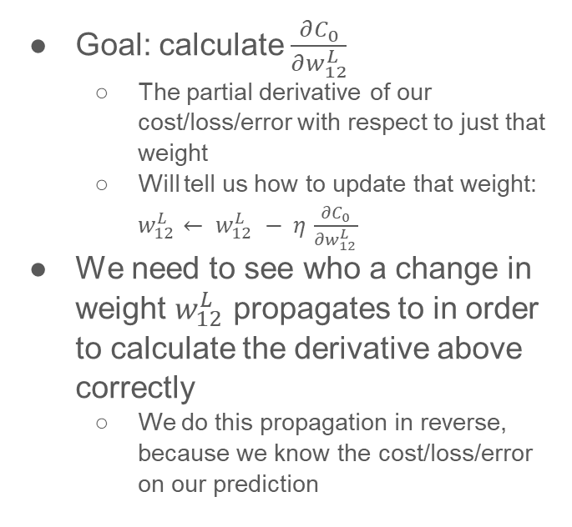
Back propagation algorithm: high level intuition
Images from https://www.youtube.com/watch?v=Zr5viAZGndE&list=RDCMUC4UJ26WkceqONNF5S26OiVw&index=2
Goal: calculate $\frac{∂C_{0}}{∂w_{12}^{L}}$
The partial derivative of our cost/loss/error with respect to just that weight
Will tell us how to update that weight: $w_{12}^{L}← w_{12}^{L} − η$ $\frac{∂C_{0}}{∂w_{12}^{L}}$
We need to see who a change in weight $w_{12}^{L}$ propagates to in order to calculate the derivative above correctly
We do this propagation in reverse, because we know the cost/loss/error on our prediction

Slide 11
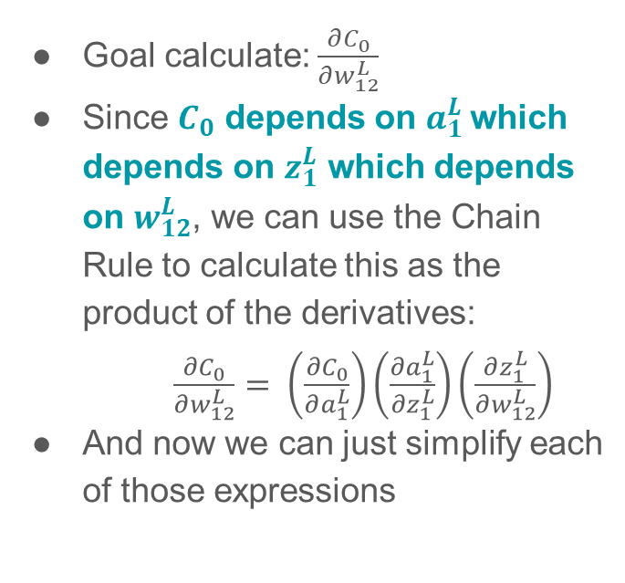
Back propagation algorithm: low level intuition
Images from https://www.youtube.com/watch?v=Zr5viAZGndE&list=RDCMUC4UJ26WkceqONNF5S26OiVw&index=2
$w_{12}^{L}$ $→ z_{1}^{L}→$ $a_{1}^{L}→$ $C_{0}$
Goal calculate: $\frac{∂C_{0}}{∂w_{12}^{L}}$
Since $C_{0}$ depends on $a_{1}^{L}$which depends on $z_{1}^{L}$ which depends on $w_{12}^{L}$, we can use the Chain Rule to calculate this as the product of the derivatives:
$\frac{∂C_{0}}{∂w_{12}^{L}}$ $= \left(\frac{{∂C}_{0}}{∂a_{1}^{L}}\right)\left(\frac{∂a_{1}^{L}}{∂z_{1}^{L}}\right)\left(\frac{∂z_{1}^{L}}{∂w_{12}^{L}}\right)$
And now we can just simplify each of those expressions

Slide 12

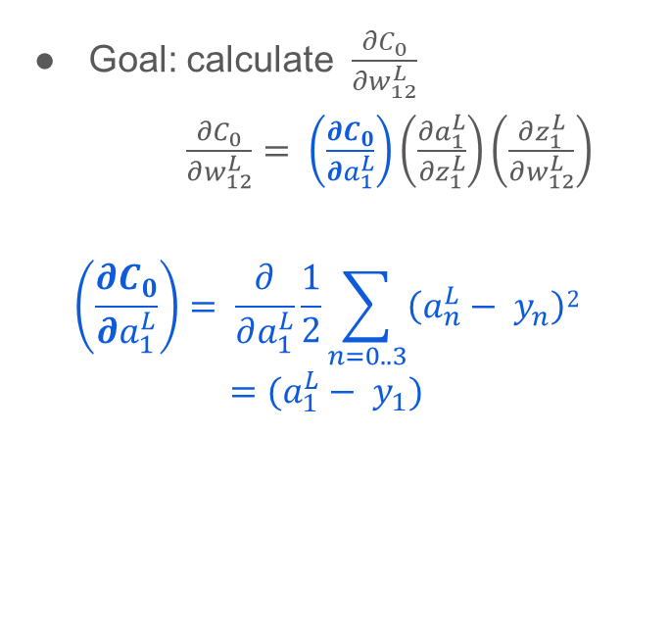
Back propagation algorithm
Images from https://www.youtube.com/watch?v=Zr5viAZGndE&list=RDCMUC4UJ26WkceqONNF5S26OiVw&index=2
Goal: calculate $\frac{∂C_{0}}{∂w_{12}^{L}}$
$\frac{∂C_{0}}{∂w_{12}^{L}}$ $= \left(\frac{{∂C}_{0}}{∂a_{1}^{L}}\right)\left(\frac{∂a_{1}^{L}}{∂z_{1}^{L}}\right)\left(\frac{∂z_{1}^{L}}{∂w_{12}^{L}}\right)$
$$\left(\frac{{∂C}_{0}}{∂a_{1}^{L}}\right)= \frac{∂}{∂a_{1}^{L}}\frac{1}{2}\sum_{n=0..3}{\left(a_{n}^{L}− y_{n}\right)2}$$
$$=(a_{1}^{L}− y_{1})$$
just an example of a loss function

Slide 13
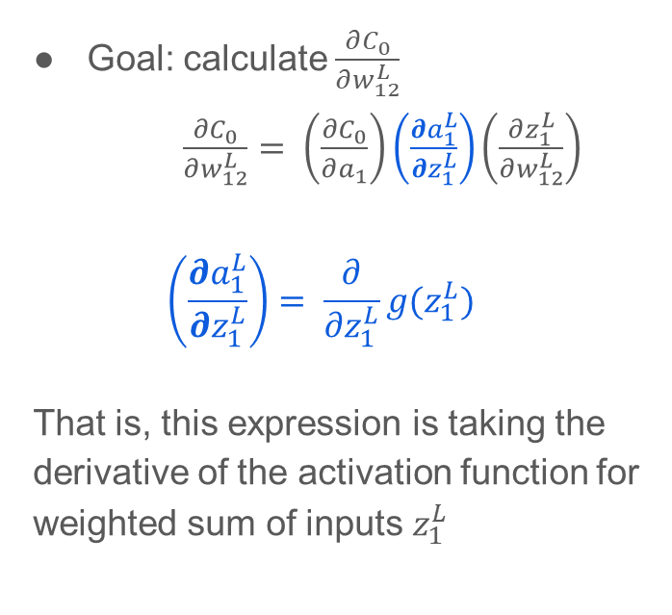
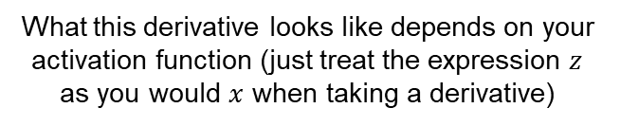
Back propagation algorithm
Images from https://www.youtube.com/watch?v=Zr5viAZGndE&list=RDCMUC4UJ26WkceqONNF5S26OiVw&index=2
What this derivative looks like depends on your activation function (just treat the expression $z$ as you would $x$ when taking a derivative)
Goal: calculate $\frac{∂C_{0}}{∂w_{12}^{L}}$
$\frac{∂C_{0}}{∂w_{12}^{L}}$ $= \left(\frac{{∂C}_{0}}{∂a_{1}}\right)\left(\frac{∂a_{1}^{L}}{∂z_{1}^{L}}\right)\left(\frac{∂z_{1}^{L}}{∂w_{12}^{L}}\right)$
$$\left(\frac{∂a_{1}^{L}}{∂z_{1}^{L}}\right)= \frac{∂}{∂z_{1}^{L}}g(z_{1}^{L})$$
That is, this expression is taking the derivative of the activation function for weighted sum of inputs $z_{1}^{L}$
$$z_{j}= \sum_{k}{w_{jk}a_{k}}$$
NOT the margin!

Slide 14
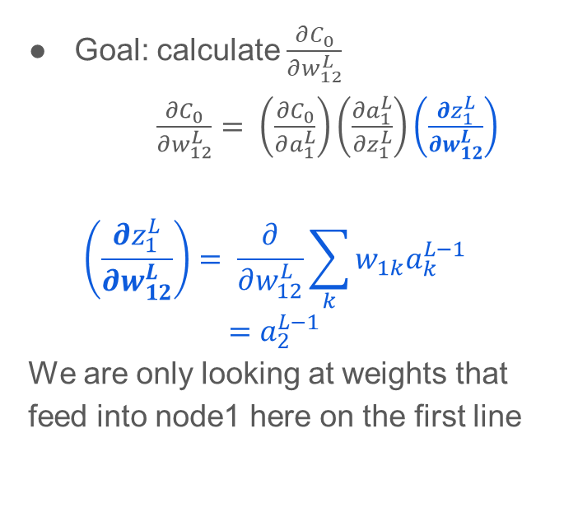
Back propagation algorithm
Images from https://www.youtube.com/watch?v=Zr5viAZGndE&list=RDCMUC4UJ26WkceqONNF5S26OiVw&index=2
Goal: calculate $\frac{∂C_{0}}{∂w_{12}^{L}}$
$\frac{∂C_{0}}{∂w_{12}^{L}}$ $= \left(\frac{{∂C}_{0}}{∂a_{1}^{L}}\right)\left(\frac{∂a_{1}^{L}}{∂z_{1}^{L}}\right)\left(\frac{∂z_{1}^{L}}{∂w_{12}^{L}}\right)$
$$\left(\frac{∂z_{1}^{L}}{∂w_{12}^{L}}\right)= \frac{∂}{∂w_{12}^{L}}\sum_{k}{w_{1k}a_{k}^{L−1}}$$
$$=a_{2}^{L−1}$$
We are only looking at weights that feed into node1 here on the first line

Slide 15
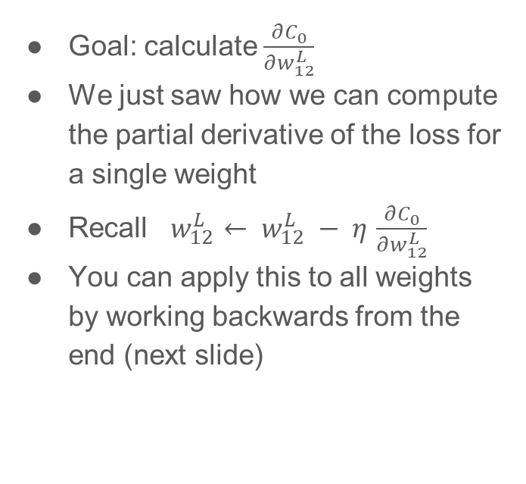
Back propagation algorithm
Images from https://www.youtube.com/watch?v=Zr5viAZGndE&list=RDCMUC4UJ26WkceqONNF5S26OiVw&index=2
Goal: calculate $\frac{∂C_{0}}{∂w_{12}^{L}}$
We just saw how we can compute the partial derivative of the loss for a single weight
Recall $w_{12}^{L}← w_{12}^{L} − η$ $\frac{∂C_{0}}{∂w_{12}^{L}}$
You can apply this to all weights by working backwards from the end (next slide)
done!

Slide 16
Let’s pause and review!
What is the point of all this?
Know how much to update a single weight
You’d do this for all weights…
What else do we need to know?
How about a weight in the middle layer?
We’ll see this next class
Let’s go back to the in-class exercise on slide 3
Video from: https://www.youtube.com/watch?v=Ilg3gGewQ5U

Slide 17
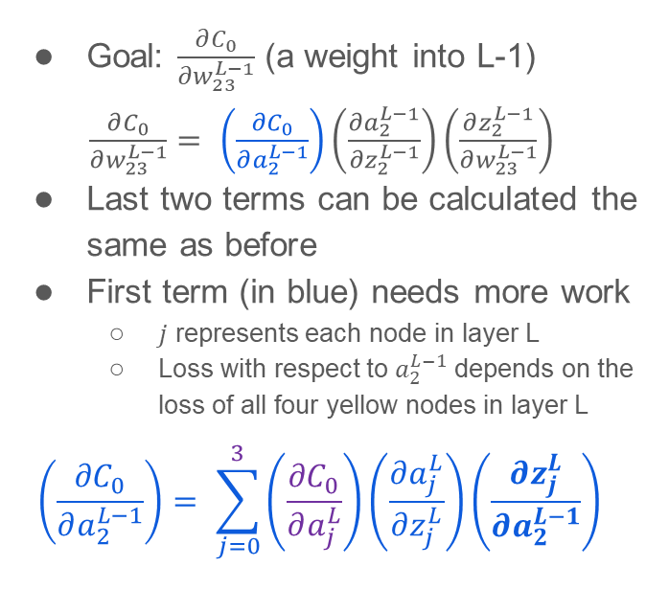


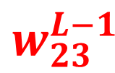
Back propagation algorithm
Images from https://www.youtube.com/watch?v=Zr5viAZGndE&list=RDCMUC4UJ26WkceqONNF5S26OiVw&index=2
$\frac{∂C_{0}}{∂w_{12}^{L}}$ $= \left(\frac{{∂C}_{0}}{∂a_{1}^{L}}\right)\left(\frac{∂a_{1}^{L}}{∂z_{1}^{L}}\right)\left(\frac{∂z_{1}^{L}}{∂w_{12}^{L}}\right)$
formula from previous slides
Goal: $\frac{∂C_{0}}{∂w_{23}^{L−1}}$ (a weight into L-1)
$\frac{∂C_{0}}{∂w_{23}^{L−1}}$ $= \left(\frac{{∂C}_{0}}{∂a_{2}^{L−1}}\right)\left(\frac{∂a_{2}^{L−1}}{∂z_{2}^{L−1}}\right)\left(\frac{∂z_{2}^{L−1}}{∂w_{23}^{L−1}}\right)$
Last two terms can be calculated the same as before
First term (in blue) needs more work
$j$ represents each node in layer L
Loss with respect to $a_{2}^{L−1}$ depends on the loss of all four yellow nodes in layer L
$$\left(\frac{{∂C}_{0}}{∂a_{2}^{L−1}}\right)= \sum_{j=0}^{3}{\left(\frac{{∂C}_{0}}{∂a_{j}^{L}}\right)}\left(\frac{∂a_{j}^{L}}{∂z_{j}^{L}}\right)\left(\frac{∂z_{j}^{L}}{∂a_{2}^{L−1}}\right)$$
$$w_{23}^{L−1}$$
3
Just saw how to calculate
simplifies to $w_{j2}^{L}$

Slide 18

Back propagation algorithm
Images from https://www.youtube.com/watch?v=Zr5viAZGndE&list=RDCMUC4UJ26WkceqONNF5S26OiVw&index=2
Notice as we move deeper into the network (towards the inputs), two things are happening:
We have to calculate $\frac{{∂C}_{0}}{∂a_{j}^{L−n}}$
We’re multiplying together lots of gradients because of the Chain Rule
$$w_{23}^{L−1}$$
3

Slide 19
Neural Nets in practice
Objective/loss function has many local optima (non-convex)
Random initialization of weights better than starting them at zero
Since it’s less likely to find the global minimum, we employ stopping criteria
Training is harder
Up to millions/billions of weights to train
Typically needs several iterations (epochs) on the training data, which can take a long time
Computationally expensive: move to GPUs
More items to tune (that can make a big difference in performance!):
Number of layers
Number of nodes in a layer
We typically choose the learning rate (step size) for gradient descent
Results are much harder to interpret
What did the model learn?
We can take a look at activation layers
These more powerful models can overfit, if we’re not careful

Slide 20
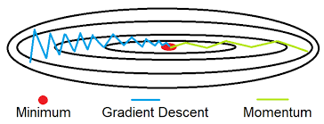
Options for improving training performance
Batch the samples in gradient descent
For batches, you can average the changes to each weight across all samples to decide what to update the weight by
Vanilla GD goes through all samples; SGD updated weights for each example, which is faster, but sensitive to noise
Another option is Minibatch gradient descent: use a small set of examples to update weights; still faster, but less sensitive to noise
Use momentum
Set a velocity term that accumulates moving average of past gradients, while still having the step size decrease (decay) as we move closer to the minimum
Adds in the previous direction to the current weight update
Allows for faster learning by avoiding oscillation
Regularization of weight size with a penalty
Scale/normalize your features!
Image from https://cedar.buffalo.edu/~srihari/CSE676/8.3%20BasicOptimizn.pdf

Slide 21
Pseudocode for training a neural net using mini-batches
for iteration in epochs:
for batch in training_samples:
inputs, targets = batch
outputs = model(inputs)
output_loss_batch = loss_function(outputs, targets)
model.updateWeights(output_loss_batch, step_size)
Preparing for deep learning
The pseudocode above is NOT identical to how this looks in PyTorch – this example is for the OOP folks

Slide 22
What is deep learning?
We have already seen them with MLPs...
Imagine much deeper networks with 50+ layers
Each layer might have hundreds or thousands of nodes
These can be fully connected to one another (as we saw so far)
Often have many features:
A 224x224 RGB image generates 3 x 50,176 = 150,528 features
Owing to many features and many layers, they can have millions+ of weights that need to be trained
They tend to be data-hungry in general
They probably need to be trained on a GPU as opposed to a CPU

Slide 23
History of NNs and deep learning
Perceptron proposed in 1957 by Frank Rosenblatt
Misplaced hope in the 1980s to change the world?
Back propagation popularized
MLP as universal approximator
But what did computing look like in the 1980s?
Not much traction through the 2000s
Hard to train NNs
RandomForests and SVMs (later in this course, linear model) performed well and much easier to deal with
Revival during 2010s+
Easier to train NNs
GPUs and big data
ImageNet and BERT were large, pre-trained models that became easy to use (more later)

Slide 24
Common use cases for deep learning
Images
Classification (and recognition) -- is this a cat or a dog?
Segmentation -- find the tumor in this mammogram
Synthesis -- generate a fake person: https://thispersondoesnotexist.com/
Style transfer -- make this image of a cat look like a painting
Natural Language Processing (later lecture)
Classification -- label the topic of this sentence
Regression -- score how upbeat this movie review was
Question-Answering -- provide an answer to this question
Machine translation
Auto-complete sentences
And many more examples!
For example, other input formats such as audio, DNA, etc.

Slide 25
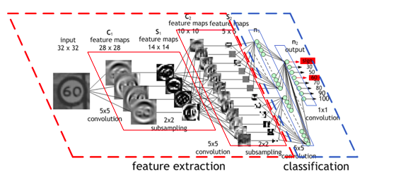
What does a deep learning model architecture look like?
An example of a NN to classify the speed limit on a road sign:
Notice the number of nodes in each layer shrinking as we move towards classification
Image from https://developer.nvidia.com/discover/convolutional-neural-network

Slide 26
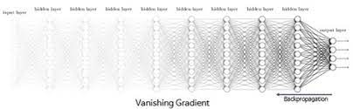
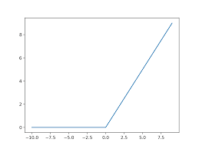
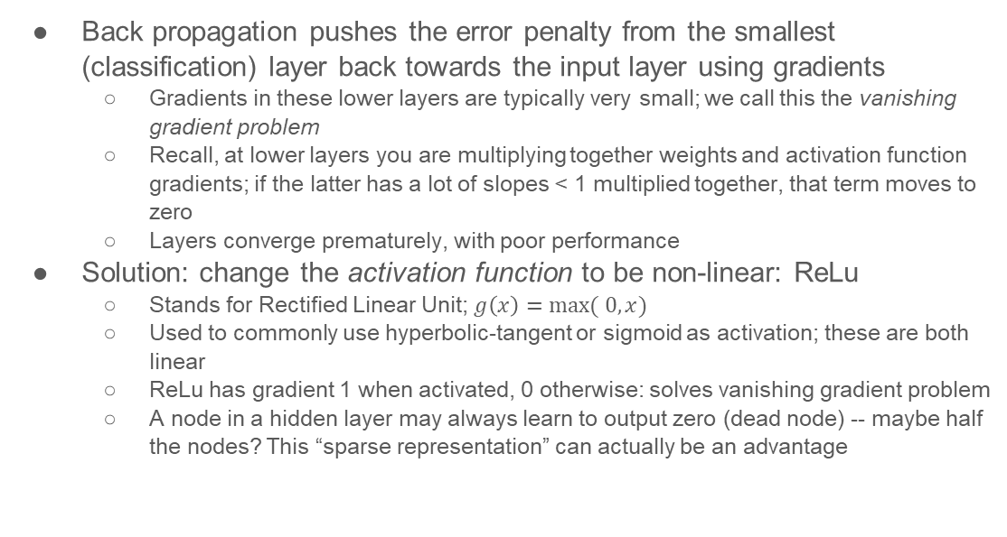
What are some additional issues with such large models?
Back propagation pushes the error penalty from the smallest (classification) layer back towards the input layer using gradients
Gradients in these lower layers are typically very small; we call this the vanishing gradient problem
Recall, at lower layers you are multiplying together weights and activation function gradients; if the latter has a lot of slopes < 1 multiplied together, that term moves to zero
Layers converge prematurely, with poor performance
Solution: change the activation function to be non-linear: ReLu
Stands for Rectified Linear Unit; $g\left(x\right)=max⁡( 0,x)$
Used to commonly use hyperbolic-tangent or sigmoid as activation; these are both linear
ReLu has gradient 1 when activated, 0 otherwise: solves vanishing gradient problem
A node in a hidden layer may always learn to output zero (dead node) -- maybe half the nodes? This “sparse representation” can actually be an advantage
Top image from http://web.khu.ac.kr/~tskim/NE%20Lect%2007%20Deep%20Net.pdf
Notes:
See heuristic explanation: https://stats.stackexchange.com/questions/176794/how-does-rectilinear-activation-function-solve-the-vanishing-gradient-problem-in

Slide 27
But wait, didn’t we just pick tanh over sigmoid earlier?
tanh can avoid zig-zagging (as opposed to sigmoid?) due to being centered at zero, and having zero-valued activations can mean we get stuck in local minima?
What about nodes in ReLu blocking gradient back-propagation?
“One may hypothesize that the hard saturation at 0 may hurt optimization by blocking gradient back-propagation. To evaluate the potential impact of this effect we also investigate the softplus activation: softplus(x)=log(1+ex) (Dugas et al., 2001), a smooth version of the rectifying non-linearity. We lose the exact sparsity, but may hope to gain easier training. However, experimental results tend to contradict that hypothesis, suggesting that hard zeros can actually help supervised training. We hypothesize that the hard non-linearities do not hurt so long as the gradient can propagate along some paths, i.e., that some of the hidden units in each layer are non-zero With the credit and blame assigned to these ON units rather than distributed more evenly, we hypothesize that optimization is easier.”
-- Glorot, Bordes, Bengio

Slide 28
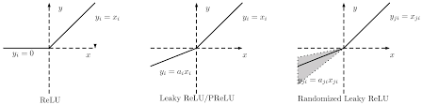
Hmmmm...disable nodes, you say?
It seems like disabling some nodes and allowing the model to learn sparse representations may actually be preferable?
However, we don’t want a node to die prematurely
This can happen with vanilla ReLU
Leaky-ReLU can help solve this problem
Other flavors of ReLU also exist
Explicit dropout:
Another technique to disable a node
In this case, randomly disables a node in the network during training: regularization
Helps with overfitting; kind of like training multiple networks simultaneously
Image from https://paperswithcode.com/method/rrelu

Slide 29
Designing deep learning architectures
Recall, these are just extensions of MLPs
Input layer of features (pixels, data, etc.)
Output layer (perhaps a node for every class you want to predict)
Hidden layer(s)
There are many different ways to specify hidden layers:
Fully connected linear: each n of N nodes in this layer connects to all nodes in the previous layer; note that the previous layer doesn’t have to have N nodes also (typically they have N+)
Convolutional layer: this layer “filters” the previous layer according to some activation
Pooling layer: collects (downsamples) the information from a previous layer
We’ll discuss convolutional and pooling layers in a bit when we talk about CNNs
An activation function is typically applied between layers

Slide 30
Homework 6: In-class exercise in groups of 2-3 students [5 min to start]
Let’s put together everything we’ve discussed using a “small” example
We’re going to build a three layer MLP using PyTorch for the same MNIST digit classification problem: download the code from Ed: https://edstem.org/us/courses/9239/discussion/709388 (modified from https://github.com/udacity/deep-learning-v2-pytorch/blob/master/intro-to-pytorch/Part%204%20-%20Fashion-MNIST%20(Solution).ipynb)
We’ll spend the rest of class walking through this example – find it on Ed and take notes!
To run it on your own, ideally you’ll want access to a GPU; you can get away with running it on the CPU, but it will be extremely slow – this is fine for the homework
You’ll need to install pytorch (see Project 0 at start of the semester)
For the next 5 minutes, read through the code/explanations and make a note of all the pieces that do and don’t make sense
But first, a little background in PyTorch and practical model training!

Slide 31
What is...PyTorch...and why are we using it?
Popular deep learning library [PyTorch vs Tensorflow?]
Allows you to train your models on the GPU
This is something that scikit-learn doesn’t do: no “deep learning” with scikit/CPU
Deep learning models utilize the concept of tensors
A tensor is just a fancy way of saying a matrix; why are matrices special in neural nets again?
I (and most people?) don’t expect you to memorize how to code anything in PyTorch
There are plenty of open source coding examples to copy and learn from -- just mind the licenses and give credit as necessary!
Do not be intimidated by the volume of code, and all the pieces that you’ve never seen
You’ll get used to reading documentation and using print statements to figure out what’s going on
To train a new model, don’t write code from scratch: modify an existing codebase
Visualizations: we won’t cover in this course, but people are fond of them, especially because deep learning models are generally such a black-boxes

Slide 32
Why deep learning practice is messy
As we saw, not even researchers are always sure of why models work they way they work, when they work, and so on
Despite our best efforts, progress is often demonstrated empirically
People can call functions/methods in the easy-to-use libraries without getting good results
Even if you understand the theory behind the models (which is often insufficiently explained for novices, requires a lot of math, and has a lot of moving parts that are difficult to visualize together)
Some people therefore skip the theory part altogether…
Be careful about reading from various blogs, etc; many people want to sound smart (good for their resume) but may not fully understand what they’re talking about...
Because the models are so black-box, it’s very easy to mess them up
Their results won’t generalize (biggest problem/concern)
You’re not pre-processing the data correctly (this is where knowing theory helps)
There are so many parameters to tune, it’s hard to know when you’re making progress, or even where to start
However, your biggest limitations will likely not be your models, but
The quality and quantity of your dataset
How much time and compute power you have
Now, back to our PyTorch example!

Slide 33
Homework 6: In-class exercise in groups of 2-3 students [5 min to start]
Let’s put together everything we’ve discussed using a “small” example
We’re going to build a three layer MLP using PyTorch for the same MNIST digit classification problem: download the code from Ed: https://edstem.org/us/courses/9239/discussion/709388 (modified from https://github.com/udacity/deep-learning-v2-pytorch/blob/master/intro-to-pytorch/Part%204%20-%20Fashion-MNIST%20(Solution).ipynb)
We’ll spend the rest of class walking through this example – find it on Ed and take notes!
To run it on your own, ideally you’ll want access to a GPU; you can get away with running it on the CPU, but it will be extremely slow – this is fine for the homework
You’ll need to install pytorch (see Project 0 at start of the semester)
Then see the next slide for graphing requirement for HW

Slide 34
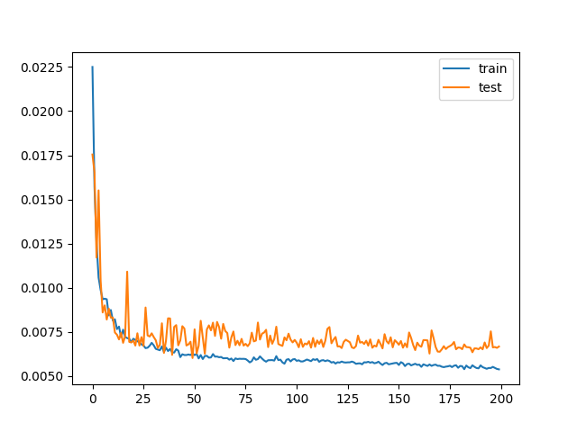
Homework 6: In-class exercise continued
Note: it is okay to run this on your CPU, it will just be very slow
Change the epochs to be 3-10 if you want to wait around for it to finish
Add code to calculate validation loss
Look up examples online how to set model.train( ) and model.eval( ) within your training loop
Visualize training and validation loss in a graph
You can find examples online for visualizing losses
Compare training to validation loss
Remember, there is no “loss curve” on the holdout
Submit your notebook on BB by 10/19 midnight

